Slide 1

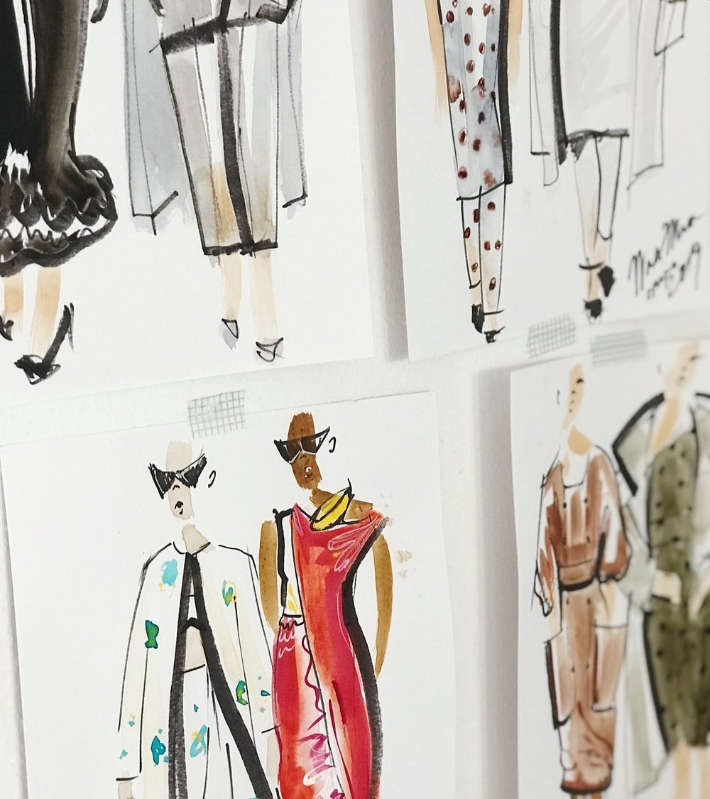


Recommendation Systems in Fashion – Changing Room
Introduction and Project Alignment
14 September 2022

Slide 2

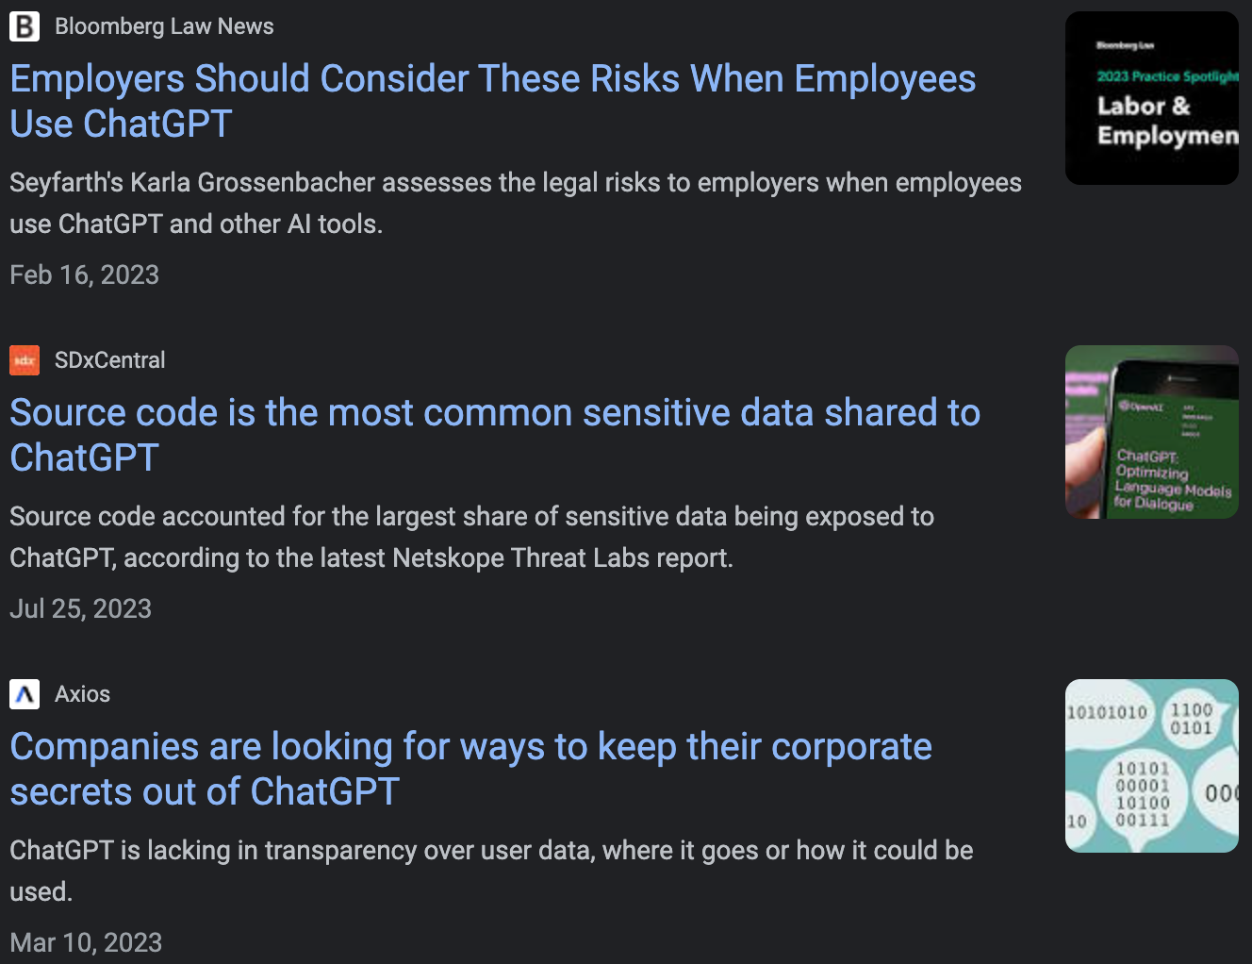
Problem Statement:
2
Our Understanding and Perspective
Our understanding of your situation
Current situation
Needs
Changing Room is looking to improve the recommendation system, and is seeking support on:
commendation system
xx
Therefore, we Olympians Consulting Group as part of Columbia University will work on this project that is tailored specifically to Changing users
Changing Room empowers consumers to reduce their environmental impact by giving them transparency on their purchases and suggesting lower-impact alternatives, in a gamified experience that allows them to celebrate their progress towards a sustainable lifestyle.
Changing Room engages with Columbia University - Management Science & Engineering Program to support the improvement of recommendation system
Changing Room
September 2022
Olympians Consulting Group

Slide 3
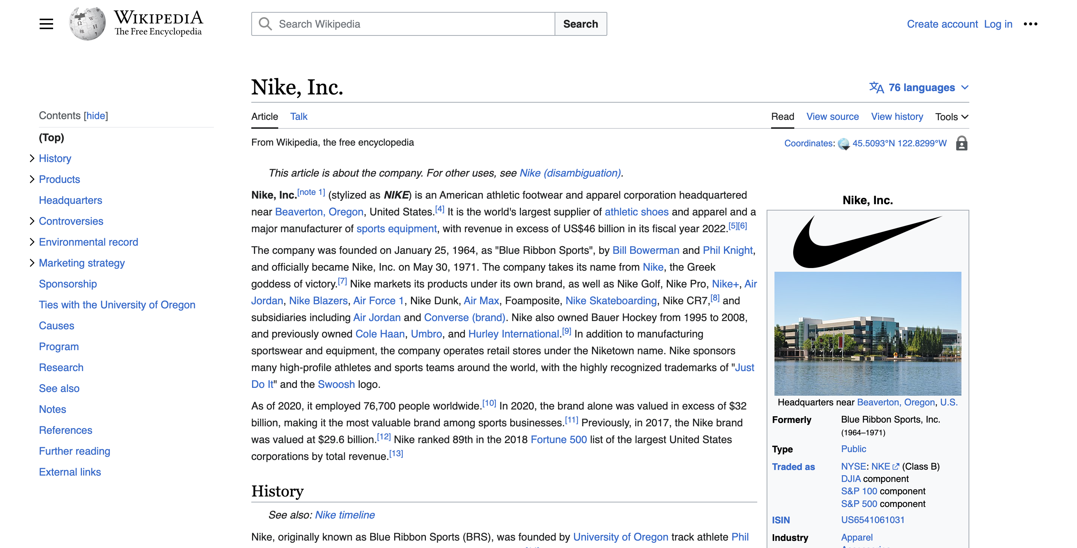
Data used
3
Questions and Clarifications
List of Questions and Clarifications
Full-Text
Question and Answer
Source: https://en.wikipedia.org/wiki/Nike,_Inc.
Olympians Consulting Group
September 2022

Slide 4
High-level Flow
3
Questions and Clarifications
List of Questions and Clarifications
Changing Room
September 2022
Olympians Consulting Group

Slide 5
Next Step
3
Questions and Clarifications
List of Questions and Clarifications
1
What is your expectation from the project?
2
What is the timeline of the project?
3
What data will we get for analysis?
4
How is the project governance? How frequent do we have project update meetings?
Changing Room
September 2022
Olympians Consulting Group

Slide 6
Acknowledgement
3
Questions and Clarifications
List of Questions and Clarifications
1
Daniel Guetta - Associate Professor at Columbia Business School / CBS, PhD
2
Andrej Karpathy - Sr Director of AI at Tesla / Stanford, PhD
3
Sophia Yang - Senior Data Scientist at Anaconda / University of Texas at Austin, PhD
4
Sreenivas Bhattiprolu - Director of Digital Solutions at Zeiss / Michigan Technological Univ., PhD
Changing Room
September 2022
Olympians Consulting Group

Slide 7

Thank you !
Changing Room

